Slide 1
Cognitive Services
Ondřej Václavek
Software engineer, HAVIT, s.r.o. vaclavek@havit.cz

Slide 2
Cognitive Services
Vision
Computer Vision – images processing
Video Indexer
Face Services
Content Moderator
Speech
Speech to Text
Text to Speech
Speaker Recognition
Speech Translation
Language understanding
Text Analysis
Text Translation
Anomaly Detection
Search
…

Slide 3
DEMO

Slide 4
Another services
Microsoft Cognitive Services - pricing
Google Cloud Vision - pricing
Amazon AWS AI - pricing
Startup Clarifai - pricing

Slide 5
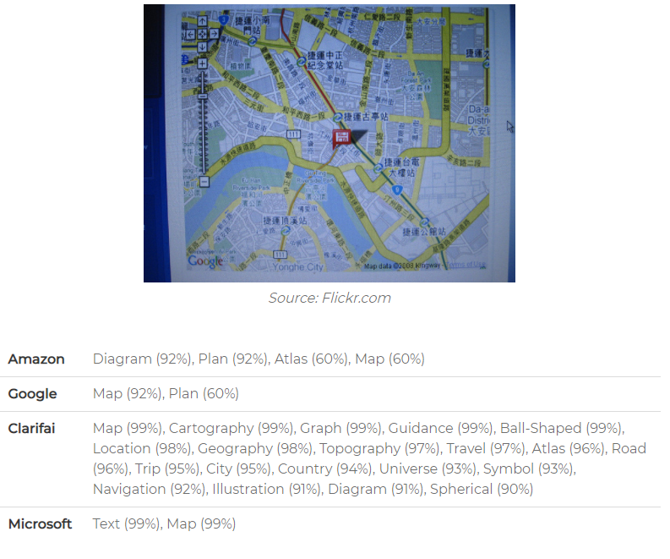

Slide 6
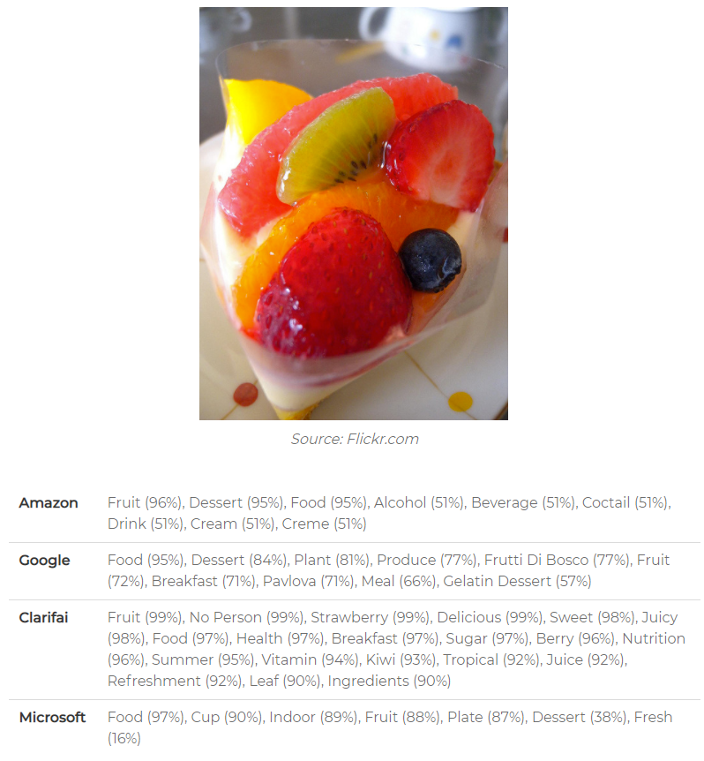

Slide 7
